Slide 1
Development of a new Python-based cardiac phantom for myocardial SPECT imaging
John Wesley Mathis
ECE/SSE 591

Slide 2
What is SPECT?
Single Photon Emission Computed Topography
Nuclear Imaging
Shows blood flow to tissues and organs
Myocardial Perfusion SPECT
Evaluates blood flow to the heart muscle
Notes:
type of nuclear imaging
Myocardial Perfusion SPECT specifically used to evaluate blood flow to the heart muscle
Helps in diagnosing various heart conditions,
Simulated Gated myocardial Perfusion SPECT

Slide 3
Anthropomorphic Human Phantoms
Objects that simulate human tissues and organs to test and calibrate imaging devices
Used in nuclear medicine
Image acquisition
Reconstruction
Data analysis
Calibration, etc

Slide 4
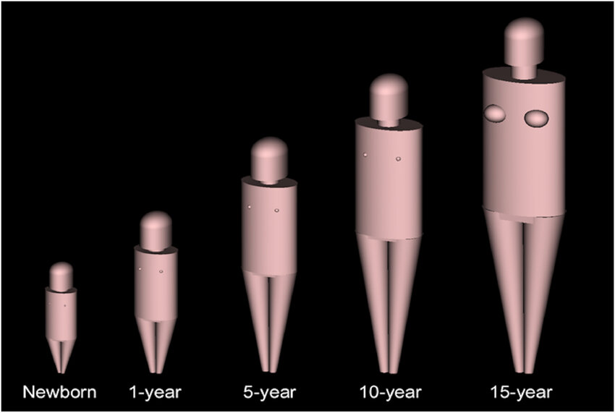
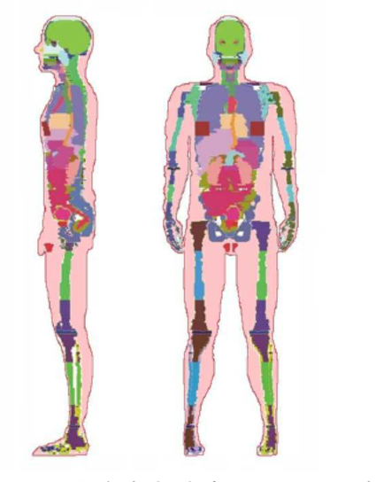
Types of Phantoms
Numerical Phantoms
Stylized Phantoms: Use mathematical equations to represent human anatomy
Analytical geometries
Voxel Phantoms: Use 3D imaging techniques like MRI or CT scans
More realistic, derived from human patients
Non-numerical phantoms
Physical models
Notes:
two types of phantoms

Slide 5
Quantitative Measurements
End Diastolic Volume(EDV)
Volume of blood in the left ventricle at the end of filling
End-Systolic Volume (ESV)
Volume of blood in the left ventricle after contraction
Ejection Fraction(EF)
Percentage of blood pumped out of the left ventricle during each heartbeat
Phase Analysis, Wall Thickening Motion, Perfusion Parameters
Various measures of heart function and blood flow
Defect Extent and Severity, Stress and Rest Scores, Total Perfusion Deficit(TPD)
Assessment of areas with poor blood flow and overall heart health
Notes:
numerous software programs that are used to derive quantitative information

Slide 6
The Problem
Current Cardiac Phantoms limited in realism and flexibility
Stylized Phantoms lack detail of anatomical model
Voxel Phantoms are rigid and less flexible

Slide 7
Study Aim
Design a computational cardiac phantom
Simulate interfering Parameters
Accurate phantom for validating and improving the quantitative analysis software
Computational Phantom
Versatile and easily modifiable
Enhances imaging accuracy and diagnosis
Notes:
design a solution that could simulate various conditions
wanted to design a phantom that was accurate
chose to design a computational phantom

Slide 8

Why use Python?
High-Level programming language
Easy Syntaxes
Flexibility
More advantages over other languages

Slide 9


Python Libraries Used
NumPy: numerical operations and matrix handling
SciPy: scientific computing, including optimization and interpolation

Slide 10
Results

Slide 11
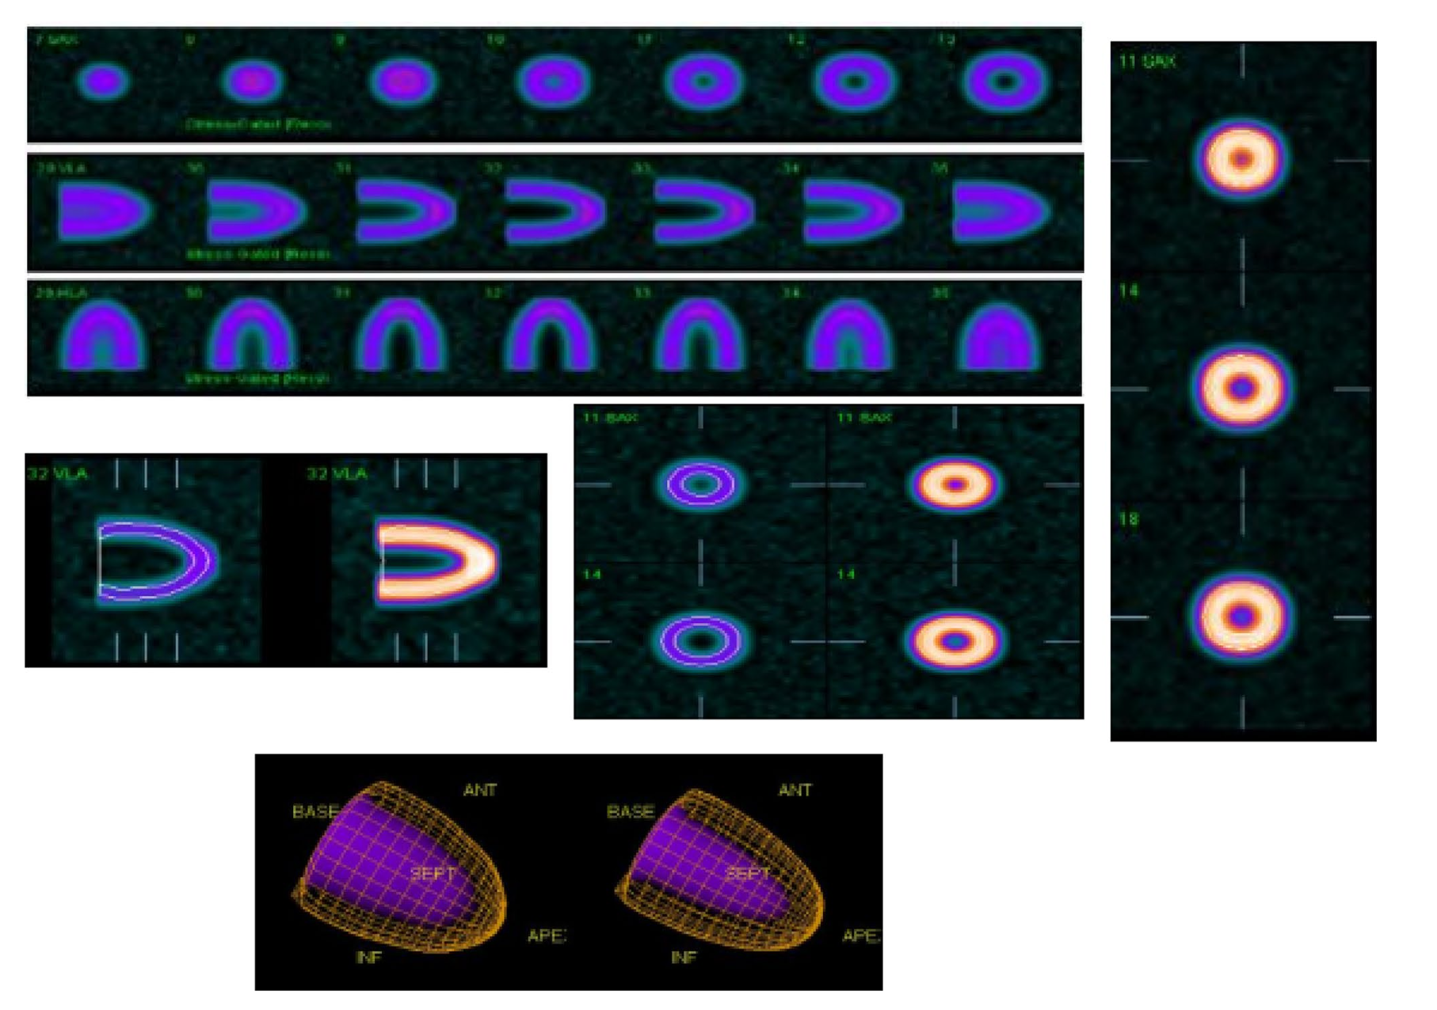
Accurate myocardial slices consistent with SPECT images
Notes:
successfully produced myocardial slices
clear demonstration of the phantoms capabilities to produce a realistic myocardial image.

Slide 12
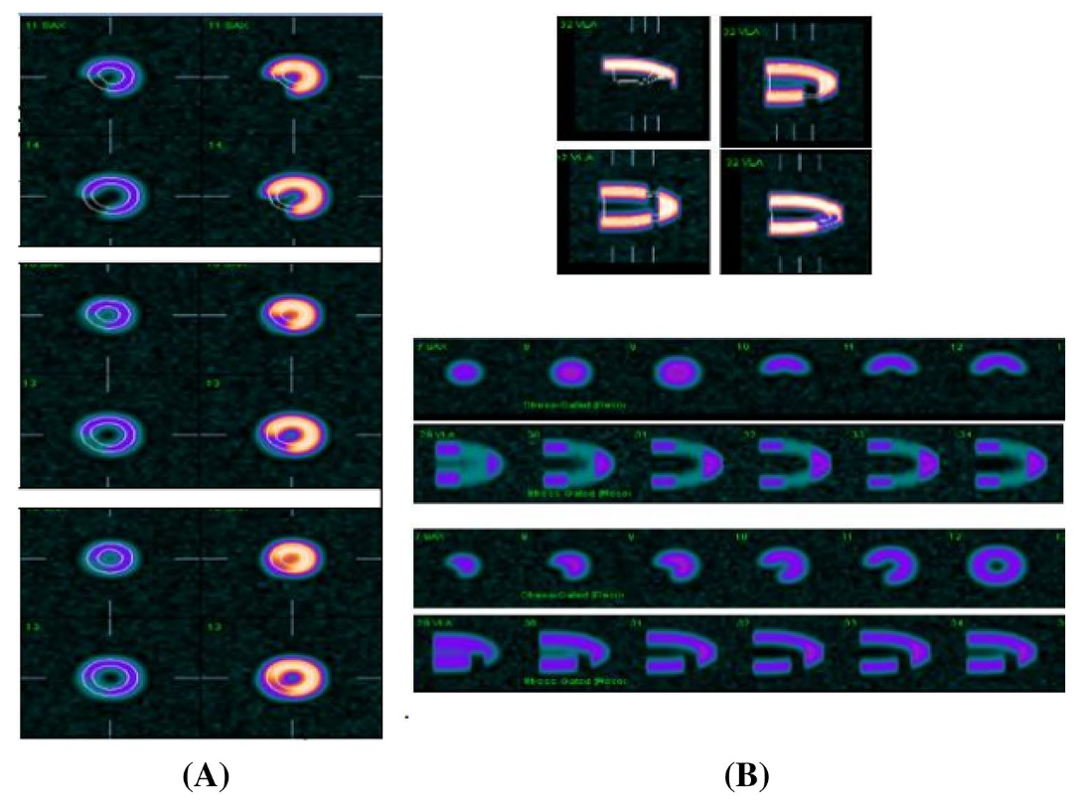
Various defect severities simulated
Notes:
show images at defects of 70, 90 and 100%. Figure 4 in the article illustrates the effect of defect severity increases and the defect count decreases proportionally.

Slide 13
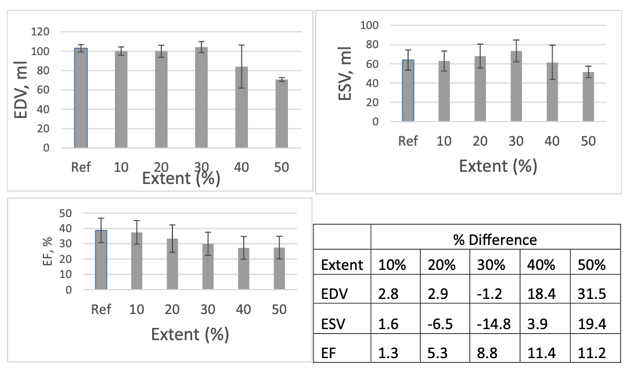
Accurate EDV, ESV, EF parameters
Notes:
figure 6 from the article.
shows the mean EDV ESV and EF for different defect extents and severities comparing the software measurements using the computational phantom with clinical data further validating the accuracy of the functional parameters and using their computational phantom.

Slide 14
My Thoughts

Slide 15
References
NumPy developers. (n.d.). NumPy logo. Retrieved from https://github/com/numpy/numpy/tree/main/branding/logo
SciPy devleopers (n.d.). Scipy logo. Retrieved from https://github.com/scipy/scipy.org/blob/main/static/images/logo.svg
Biopython. (n.d.). Biopython logo. Retrieved from https://biopython.org/wiki/logo
Hanafy, O. S., Khalil, M. M., Khater, I. M., & Mohammed, H. S. (2020). Development of a new Python‐based cardiac phantom for myocardial SPECT imaging. Annals of Nuclear Medicine, 23(1), 257. https://doi.org/10.1007/s12149-020-01534-y
Matplotlib developers. (n.d.). Matplotlib logo. Retrieved from https://matplotlib.org/stable/gallery/misc/logos2.html
pandas development team. (n.d.). Pandas logo. Retrieved from https://pandas.pydata.org/about/citing.html
Python Software Foundation. (n.d.). Python logo. Retrieved from https://www.python.org/community/logos/
Splettstoesser, T. (n.d.). Cas9 protein structure [Image]. Wikimedia Commons. Retrieved from https://en.wikipedia.org/wiki/Cas9#/media/File:Cas9_5AXW.png

Slide 16
Questions?

